Slide 1
Housing Price Predictor
Elliott, Daniel, Yuuki, William

Slide 2

Origin Of The Issue
The training, test, central problem idea came from Kaggle.

Slide 3
What Is Our Goal?
To predict the housing price of a home, based on its numerical, and heuristic values.

Slide 4
Issues Encountered With the data
Some rows had empty data
Data was not normalized on input, and had outliers

Slide 5
Data Converting Process

Slide 6
Overview
Train data was normalized and calculated correlation by Python
I used the library below:
pandas
scikit-learn (sklearn)
MinMaxScaler
OneHotEncoder
ColumnTransformer
Pipeline

Slide 7
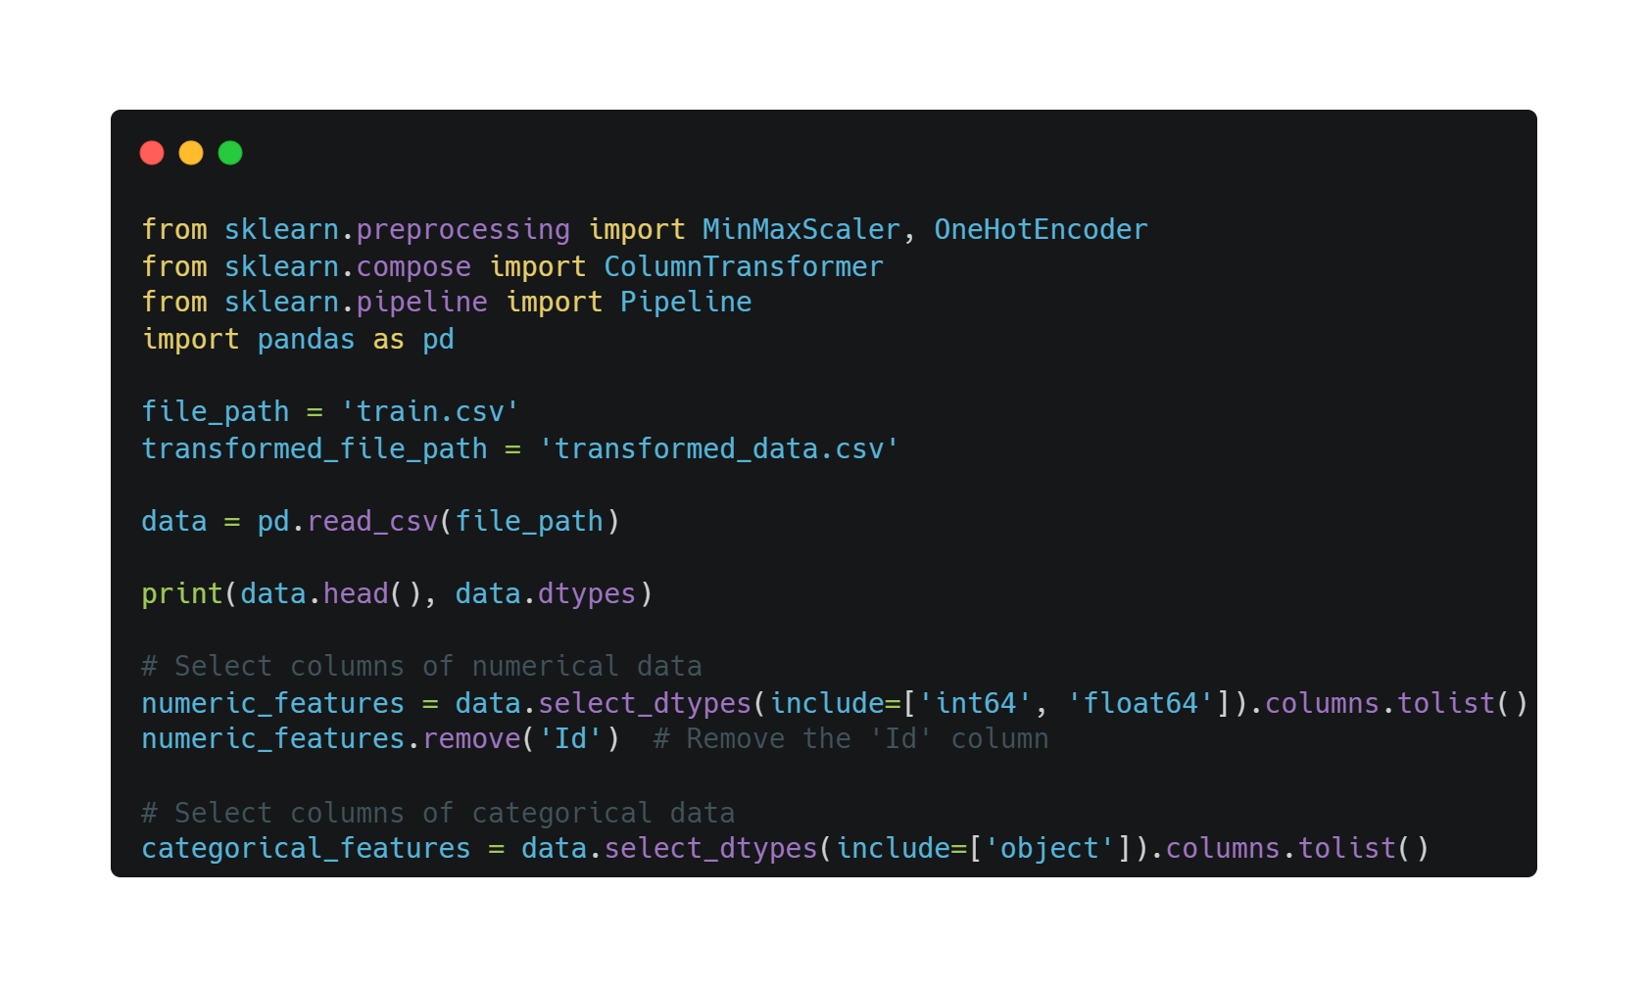
Prepare for converting
Read the data with pandas
Remove ‘id’ column because of not representing feature of the data
Select object data as non-numeric data

Slide 8
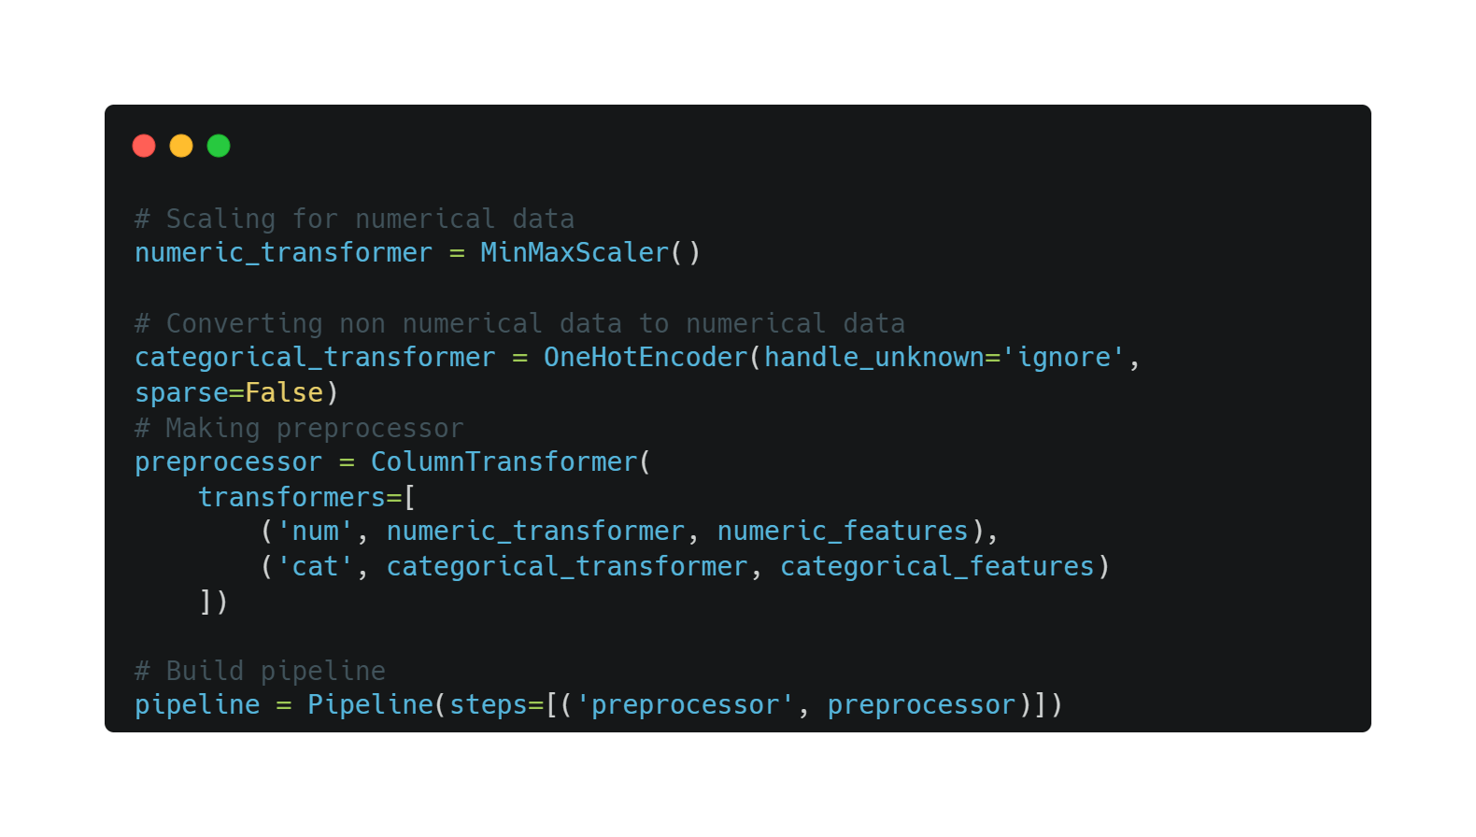
Normalizing the data
Normalizing with MinMaxScaler
Convert non-numeric data to numeric data by using OneHotEncoder
Converting data by using pipeline

Slide 9
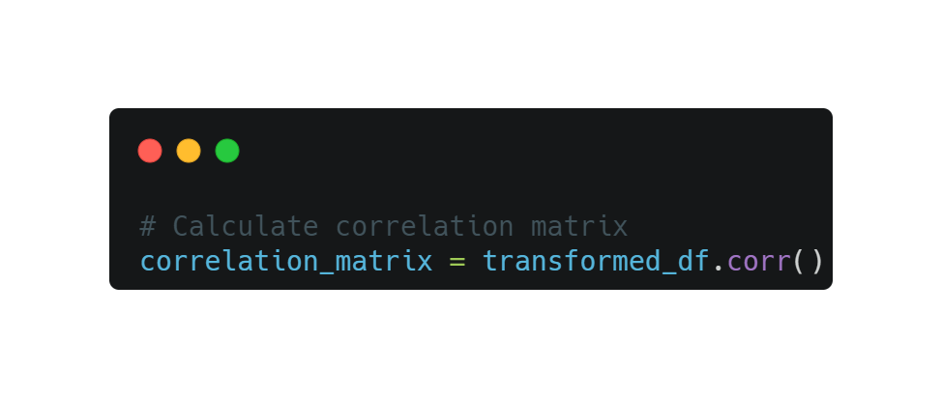
Calculating correlation
Calculating correlation by .corr()
From pandas.DataFrame

Slide 10
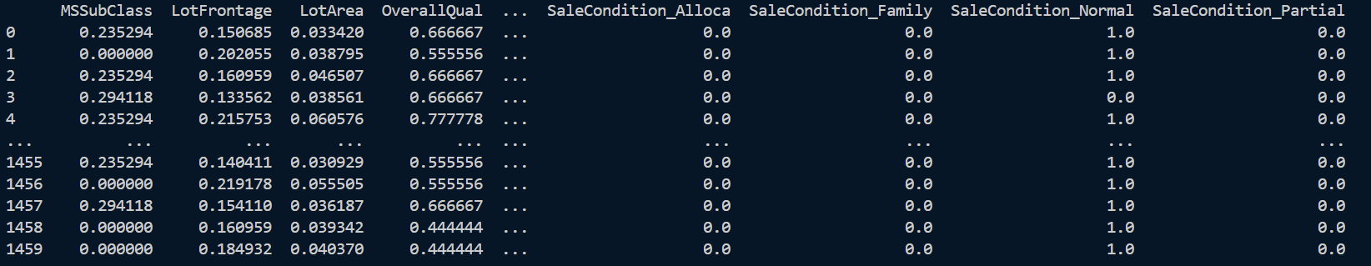
Result for Normalization

Slide 11
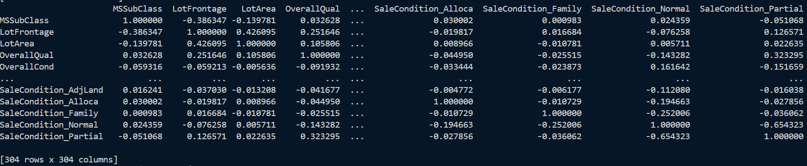
Result for Correlation

Slide 12
Regression Based
Neural Network

Slide 13
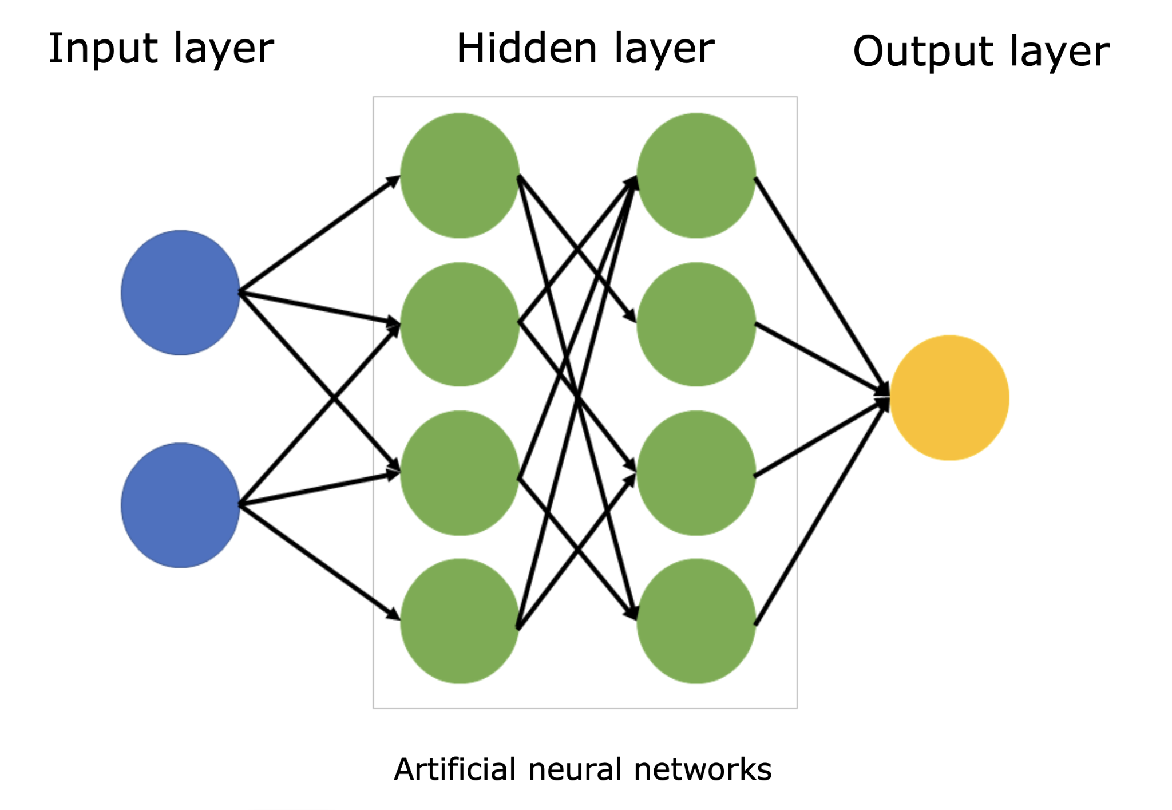

Slide 14
Generation One
Quirks Of This Generation:
-Epoch size of 50,000
-No Data Manipulation Used The 7 Nodes I thought were best based on intuition
-Average 39.057224386714806% Off
-On average $68,362.96361650118 off
-7 Input Nodes
-1 Hidden Layer(64 nodes)
-Test, and Train RMSE: Suggests an underfitting even with this many epochs

Slide 15
Generation Two
Quirks Of This Generation:
-Epoch size of 5,000 (Input size is so much larger, I do not have the computation to train at the same sizes)
-All Data Is Normalized And Converted Into Tensors
-Average 1.1546183536253137% Off
-On average $2317.936820724616 off
-303 Input Nodes
-2 Hidden Layer (912 Nodes, and 64 Nodes)
-Test, and Train RMSE: Suggests an overfitting even with this few epochs

Slide 16
Generation Three
Quirks Of This Generation:
-Epoch size of 50,000
-Normalized Data, but only the values with a confidence value of 0.5 or greater
-Average 10.892597680662763% Off
-On average $19255.83460340934 off
-14 Input Nodes
-1 Hidden Layer(64 Nodes)

Slide 17
Generation Four
Quirks Of This Generation:
-Epoch size of 50,000
-Same Data Used As Generation Three
-Average 5.198773149685494% Off
-On average $8840.115347799174 off
-14 Input Nodes
-2 Hidden Layer(128 Nodes, and 64 Nodes)
-Test, and Train RMSE: Suggests an extreme underfitting even with this many epochs

Slide 18
Generation Five
Quirks Of This Generation:
-Epoch size of 50,000
-Same Data Used As Generation Three, and four
-Average 5.1779640127089785% Off
-On average $6843.653014862474 off
-14 Input Nodes
-3 Hidden Layer(196 Nodes, 196 Nodes, 64 Nodes)

Slide 19
Generation Six
Quirks Of This Generation:
-Epoch size of 50,000
-Same Data Used As Generation Three, four, and five
-Average 2.3318138667737645% Off
-On average 4353.077234538794$ off
-14 Input Nodes
-3 Hidden Layer(196 Nodes, 784 Nodes, 64 Nodes)

Slide 20
Random Forest Regressor

Slide 21
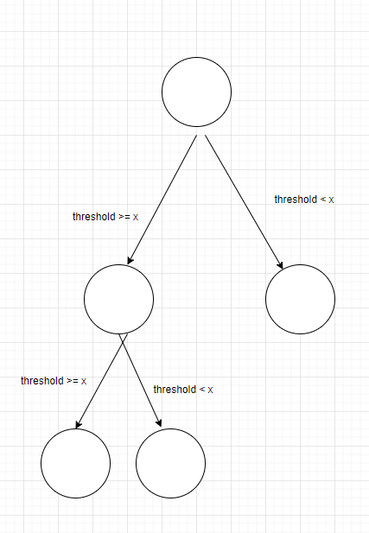
Decision Tree
Splits at the dataset depending
on a threshold
Takes in all features

Slide 22
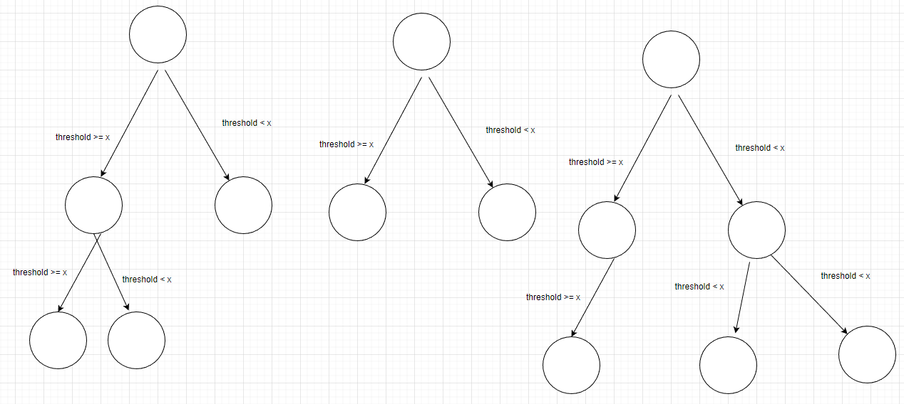
Random Forest
Creates n number of trees
Randomizes the features that
The trees receive

Slide 23
Features Used
'LotArea','OverallQual','OverallCond','YearBuilt', 'GrLivArea', 'TotRmsAbvGrd', 'YrSold'
The Random forest randomized which features the decision trees were built with
Found that adding more features did not improve RMSE by a noticeable margin

Slide 24
Testing
Most of testing was trying to find optimal tree depth in the decision tree and number of trees in the random forest
Also compared RMSE between just decision tree and random forest to see if random forest is more accurate
Each testing configuration was done on 50 randomizations of the data set

Slide 25
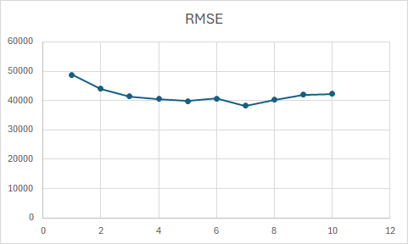
Results of Decision Tree
Values are average RMSE between the predictions and test set

Slide 26
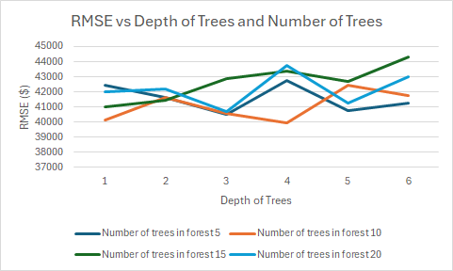
Results of Random Forest
Values are average RMSE between the predictions and test set

Slide 27
Naive Bayes

Slide 28
Motivation
A more simplistic approach towards predicting housing sales prices.
Given the vast amount of data fields in our data set, it is inherently difficult to account for them all, while some might not even be useful.
Naive bayes allows us to roughly predict sale prices as more of an initial look/attempt by assuming the data fields are conditionally independent of each other.

Slide 29
Method
Given that naive bayes (generally) aims for binary classification predictions while the nature of predicting sales prices varies widely, we instead broadened into two outcomes: sales prices that are >= or < a cutoff.
The goal is to roughy predict where a sale price may lie within a given range from an initial estimate price.
Our implementation focuses on four conditional data fields deemed important: sale condition, sale type, year sold, and month sold.

Slide 30
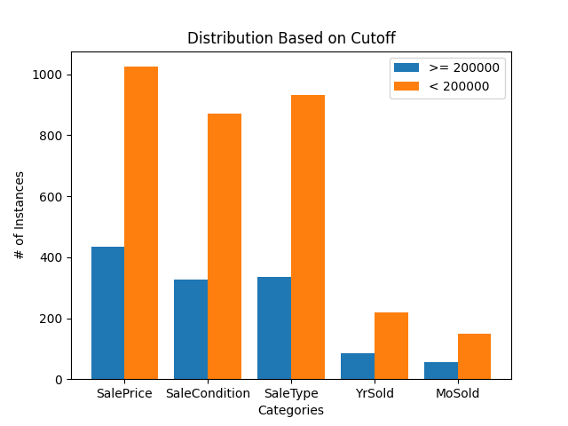
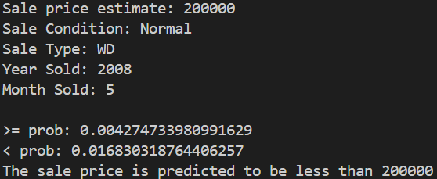
Results

Slide 31
Closing Thoughts
Naive bayes was a light attempt at predicting sales prices, but it can help us to gain a better understanding on the impact of the different data fields and to see where trends may lie.
While we only accounted for four data fields, our implementation could be extended to include more, if not most fields from our data set.
Various combinations of conditionals from the data fields could be freely chosen to determine which ones have the greatest impact in predictions.

Slide 32
Conclusion

